Slide 1
OBD Inspection Tool with Tampering Detection Presentation to I/M Solutions Forum
May 2023
Richard Walter, PE

Slide 2
Causes of High Emission Vehicles
Problem
Mal-Maintenance (inaction to repair vehicle)
Non-Compliance (actively modifying the vehicle)
I/M Fraud (the submitted data is not legitimate)
Solution
I/M program
Tamper detection program
Fraud detection program

Slide 3
I/M & Tamper Detection Requirements
I/M Inspection – pass/fail or incomplete - Based on readiness, DTCs and VIN match - Assumes a non-tampered vehicle
Tamper detection - Evaluate additional DMs, operating parameters, patterns and more

Slide 4
Target Vehicles
Diesel LD, MD and HD vehicles (all classes)
MY 2010 to present
Acquire both J1979 and J1939 data
Most HD vehicles use the J1939 standard
A few HD models (i.e., Volvo & Mack) use the LD J1979 standard
Medium-duty vehicles by LD automotive OEMs use the J1979 standard
Adaptable to off-road vehicles – EPA testing is on-going

Slide 5
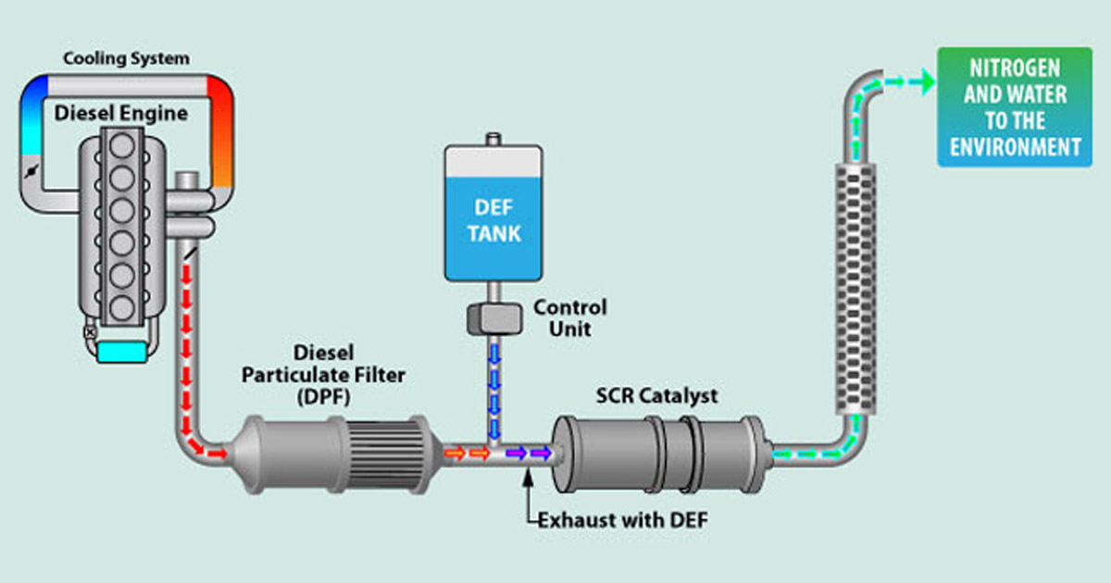
What is Emission Tampering?
Tampering is:
- deleting equipment,
- reflashing ECUs, or
- adding an emulator.

Slide 6
Why is it Important to Detect Tampering?
Tampered vehicles are likely among the highest polluters
Likely more than 10% of vehicles tampered after a few years
Need to quantify the extent of tampering and emission effects
How effective is an inspection program if tampered vehicles (high polluters) pass?
Therefore, a diesel inspection tool & tampering detection tool are both essential!

Slide 7
HEM Data’s Solution
An affordable, portable solution that is easily moved from vehicle to vehicle – high productivity.
Ideal for roaming inspectors, dealers, and kiosks
DAWN is the umbrella name for HEM Data’s products – DAWN = Data Acquisition with Networks
Inspection is completed in 2 minutes acquiring all required data

Slide 8
HEM Data’s Solution
DAWN OBD InspectorTM
Customized to meet various I/M program requirements
Tool to acquire necessary data
Analyze and report pass/fail based on jurisdiction‘s requirements (optional)
DAWN OBD InspectorTM with TamperDetectTM
Detect tampering
Can be part of an I/M program or an independent program

Slide 9
CARB I/M Program
The California Air Resource Board
(CARB) will likely certify in May HEM Data’s DAWN OBD Inspector™ for use with their CARB HD I/M Program.

Slide 10
DAWN OBD InspectorTM is designed for
Tampering studies and programs
Future federal and state I/M programs
Service and repair technicians
Researchers
Companies who resell or buy trucks and off-road vehicles

Slide 11
DAWN OBD InspectorTM
Reports all diagnostic data
J1979 & J1979-2 Test Modes (Service IDs),
J1939 Diagnostic Messages (DMs), and
Emission related parameters (SPNs & PIDs)
J1939 and J1979 data formats are quite different. Complications:
Data is sent by multiple controllers.
Only some parameters need to be requested in J1939; J1979 requires requests
HEM Data's has the ability to provide the required data needed for any specific I/M OBD program. Adaptable to various jurisdictions.

Slide 12
DAWN OBD Inspector™ Components
DAWN Mini Streamer™ hardware (dongle)
DAWN OBD Inspector™ software (app)
iPad or iPhone; PC supported in the near future
HD-OBD Inspector Dashboard™ (database of 75,000 inspections) - Optional

Slide 13
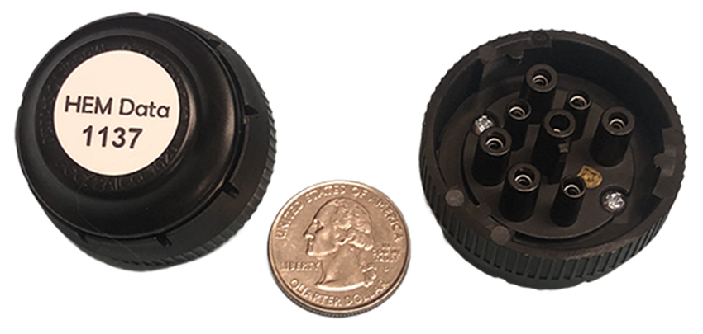
HEM Data’s DAWN Mini Streamer™
Conveniently fits directly on the 9-pin J1939 connector
An adapter cable works for the 16-pin J1962 automotive connector or a non-standard connector
Baud rates of 250k, 500k, and 1000k are automatically detected
Wirelessly sends vehicle data to the DAWN OBD Inspector™ app. Therefore, test personnel don’t need to climb into the cab.

Slide 14
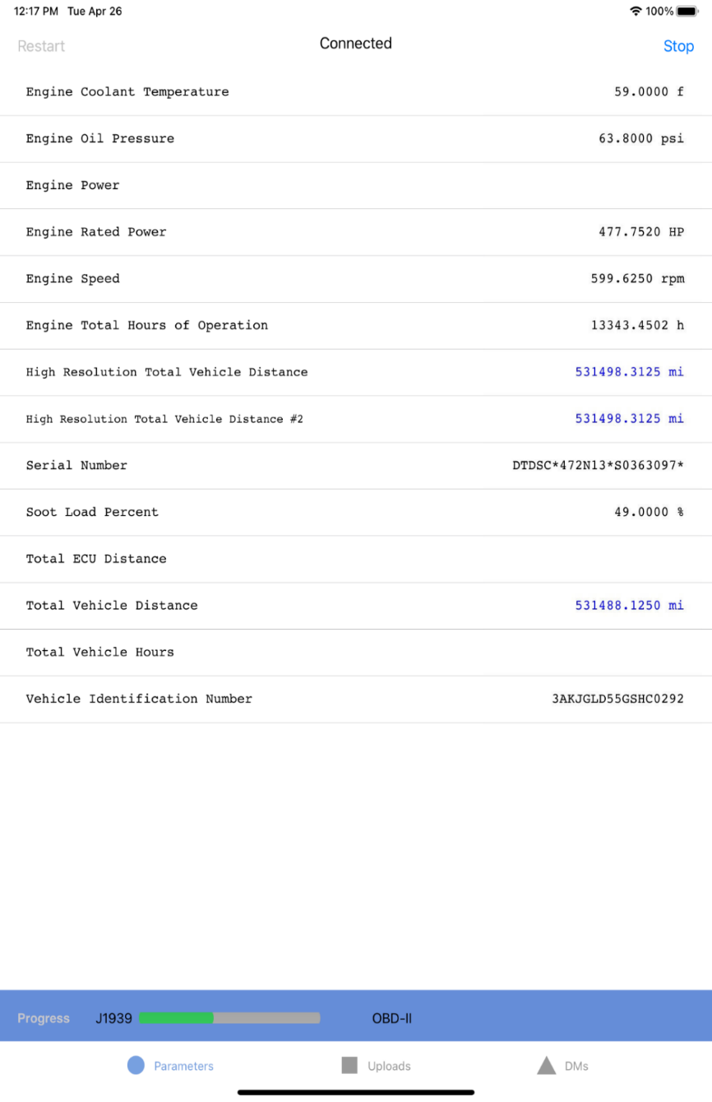
Real-Time Field Test Data
Reports key live data.
Provides feedback to the user that the test is working
Status bar shows testing progress
Separate status bars for J1939 & J1979

Slide 15
Immediate Test Results
VIN & other vehicle info + test date & time
Vehicle compared to similar vehicles averaged per year - Total miles, hours, idling, fuel used
Averages over vehicle’s life MPG, MPH, RPM compared to group
Test conditions: temps, oil pressure and battery voltage Inspection results: pass/fail, MIL on, incomplete, or tampered

Slide 16
DAWN OBD Inspector with TamperDetect™
Detect and report tampering
HEM Data developed a proprietary tampering algorithm
Currently used by HD and MD vehicle resellers
https://hemdata.com/products/dawn/dawn-inspector/
Analyze and report pass/fail based on jurisdiction‘s requirements (optional)

Slide 17
HD-OBD Inspector DashboardTM
75,000 HD vehicle inspections are stored in an HEM Data database
150 inspectors currently performing inspections, so database keeps growing
Dashboard to analyze and display inspections
Mine data to identify stations and inspectors engaging in fraud (false data), and determine the extent of vehicle tampering, etc.
Support compliance and enforcement.

Slide 18
Validation of Tampering Detection
HEM Data working with inspectors to validate our data (known customers (reputable or not), some confess, visual inspection)
EPA/ERG is conducting an independent, validation study on HEM Data’s algorithm
Test conducted during the week of February 27th
Report out in June

Slide 19
History DAWN OBD InspectorTM
2014: Inspection company initially contacts HEM Data
2016: First prototype delivered
2017: 25 inspectors start to use the tool; data is stored in a database, a report issued for each vehicle
2019: iPad app is acquiring all J1939 & J1979 data
2019: HD-OBD Inspector™ Dashboard has advanced queries and reports
2020: Number of inspectors grew from 25 to 100
2022: Grew to 150 inspectors
2023: Approaching 75,000 HD vehicles in database; adding 12,000/year
2023: Number of inspectors growing to 200.

Slide 20
All Major Vehicle Models Tested
Blue Bird
Capacity of Texas
Case IH
Caterpillar
Ford
Freightliner
GMC
Hino
International / Navistar
Kenworth
Mack
New Holland
Peterbilt
Provost
Spartan Motor Chassis
Sterling
Thomas Built
Volvo
Western Star

Slide 21
Inspector Dashboard Flowchart

Slide 22
HD-OBD Inspector DashboardTM One Database – Several Dashboards
Available Parameters – EPA using to design HDV tests
Find which parameters of interest are on a HDV model
Varies with model years and manufacturers
Use commonly available parameters
Focus on a Single Vehicle –Vehicle inspection
Lists its DTCs, key parameters, and whether it passes inspection or has tampered emission equipment
User-Defined Group of Vehicles – Define normal parameter ranges
Determine “normal” vehicle activity
Identify vehicle models with serious problems
Quantify tampering & mal-maintenance
Improved modeling – based on activity data

Slide 23
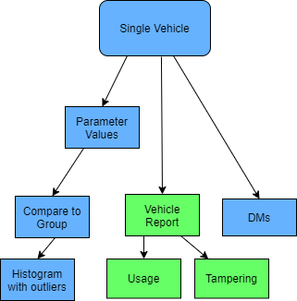
Single Vehicle Inspection
List key parameters for vehicle
Report DTCs
Report Diagnostic Messages (DMs); determine if vehicle passes inspection
Compare the vehicle to a group
Provide vehicle inspection report
Identify tampering
Determine if the vehicle can be legally resold

Slide 24
User-Defined Group
Identify common DTCs for each vehicle model
Identify vehicle models with serious problems
Define vehicle activity by class and vocation
Define normal ranges to be used in Single Vehicle analysis
Indicate mal-maintenance or tampering when outside of normal ranges
Improve modeling / better dyno testing

Slide 25
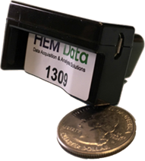
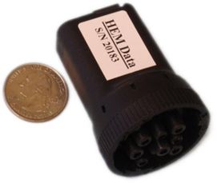
Detect intermittent problems
User selects parameters of interest to log based on the problem
Service technician temporarily installs HEM Data’s data logger
Record vehicle operation during normal operation
Review file when problem occurred
Examples are on HEM Data’s website at https://hemdata.com/consulting/

Slide 26
HEM Data consults on acquiring and analyzing OBD data
Ongoing multiple year support contracts with EPA starting six years ago
EPA and CARB have acquired over 800 HEM Data loggers
SAE has published two books written by HEM Data on acquiring OBD and CAN data from LD and HD vehicles. SAE has requested additional publications from HEM Data.

Slide 27
Summary
DAWN OBD Inspector™
Is about to be certified by CARB for their HD I/M program
Is adaptable to needs of other jurisdictions for diesel testing
DAWN OBD Inspector™ with TamperDetect™
Is being validated by EPA/ERG and HEM Data’s customer feedback
Is available now to all 50 states to detect diesel tampering

Slide 28
Questions / Additional Information
Richard Walter, P.E.
rickw@hemdata.com
HEM Data
17320 Twelve Mile Road
Southfield, MI 48076-2105
https://hemdata.com/products/dawn/dawn-inspector/
248 559-5607 x111
800 436- 4330
www.hemdata.com

